Slide 1
MARAC (Multi-Agency Risk Assessment Conference)
Sonia Knight - Domestic Abuse Programme Manager and MARAC Chair, Surrey County Council
Dave Thomas - Detective Inspector, MARAC Chair, Surrey Police
Sarah Billingham – Hourglass
Sheetal Goel – Locality Safeguarding Advisor, Surrey County Council
Barbara Savage – Locality Safeguarding Advisor, Surrey County Council

Slide 2
Agenda
Welcome and Introductions
What is MARAC?
Your Sanctuary – specialist outreach services
Hourglass
Adult Social Care Case Studies
Questions

Slide 3
What is MARAC?
A Multi Agency Risk Assessment Conference (MARAC) is a regular local meeting to discuss how to help domestic abuse victims, aged 16 or over, at high risk of murder or serious harm.
Domestic abuse specialists, police, outreach services, adult & children’s social care, health, housing, probation and other relevant agencies all meet to talk about the victim, the family and perpetrator and share information. The meeting is confidential.
Together, MARAC attendees agree an action plan for each victim. They work best when everyone involved understands their roles and the right processes to follow.

Slide 4
The Aims of MARAC?
Increase Safety
Determine the level of risk
Risk management plan
Reduce
Improve
Support for staff
Best practice
Policy issues
Focus appropriate resources
Notes:
Increase the safety, health and well-being of victims and their children
Determine the level of risk that the perpetrator poses to the victim and associated children, and whether there is any risk to the general public
Implement a risk management plan that provides professional support to all those at risk and reduce the likelihood of further harm
Reduce repeat victimisation
Improve agency accountability
Improve support for staff involved in high risk domestic abuse cases
Contribute to the development of best practice
Identify policy issues arising from cases discussed at MARACs and address these through the appropriate channels
MARACs will also seek to focus appropriate resources on the needs of the perpetrator with the aim of reducing offending behaviour and supporting the associated criminal justice process as required.

Slide 5
Where are MARACs held?
Surrey Heath and Woking
Guildford and Waverley
Tandridge, Mole Valley, Epsom and Ewell
Reigate and Banstead
Runnymede and Elmbridge
Spelthorne
All MARAC meeting are currently held virtually on Teams.
Each area heard 2 weekly.

Slide 6
9 PRINCIPLES OF AN EFFECTIVE MARAC
IDENTIFICATION – professionals recognising DA, risk assessing and identifying high-risk cases
REFERRAL - all victims who meet the MARAC threshold are referred to MARAC and Outreach
MULTI-AGENCY ENGAGEMENT – agencies that can contribute to safeguarding attend and engage
INDEPENDENT REPRESENTATION/SUPPORT – victims offered IDVA who represent their voice at MARAC
INFORMATION SHARING – representatives share relevant, proportionate and risk-focused information
ACTION PLANNING –address risk, safeguard children and adults, and manage perpetrator behaviour
EQUALITY – MARAC addresses the unique needs of victims with protected characteristics
OPERATIONAL SUPPORT – sufficient support and resources to support effective functioning
GOVERNANCE – effective strategic support and leadership to ensure agencies work together effectively

Slide 7
Referral Criteria
There are currently five criteria for assessing the risk of harm and for referring a case to the MARAC, a victim does not have to meet all of these criteria to be considered at high risk.
Visible High Risk (14 or more ticks on the DASH risk assessment)
Potential Escalation (5+ incidents over 12 months any risk)
Harmful Traditional Practices (Honour based abuse, Forced Marriage, Female Genital Mutilation )
Repeat Cases (Known to MARAC within last 12 months from date of last referral )
Professional Judgement (PLEASE REMEMBER: your professional judgement is just as important as any risk assessment score when considering a referral to MARAC, particularly where the abuse appears to be escalating)
Surrey MARAC referral form - https://customer.surreycc.gov.uk/surrey-marac
Surrey MARAC email address – MARAC@surreycc.gov.uk

Slide 8
Meeting and Action Planning?
Referring agency will present the case
All agencies will have researched case prior to the meeting and provide an update at the meeting
Chair will identify and summarise risks
Actions to address identified risks will be agreed and allocated to the relevant agency
Feedback to victim will be agreed
Notes:
Examples of actions
Welfare visit
Markers on address
Home fire safety check
Housing officer to complete visit and ensure property is secure
Housing officer to send residents in the building a reminder letter about closing the main door
Probation to let outreach know if perpetrator is attending appointments and when and where the victim is during the appointment
I-access to move script to other pharmacy
I-access to make pharmacy aware of DA risk and if victim presents with injuries to report these
Mental health to complete assertive outreach visits and feedback to worth about engagement
Mental health to ensure they are offering support in a trauma informed way based on the domestic abuse- highlight ‘barriers’ for DA victims
Adult social care to assess perpetrator to see if he has care and support needs

Slide 9
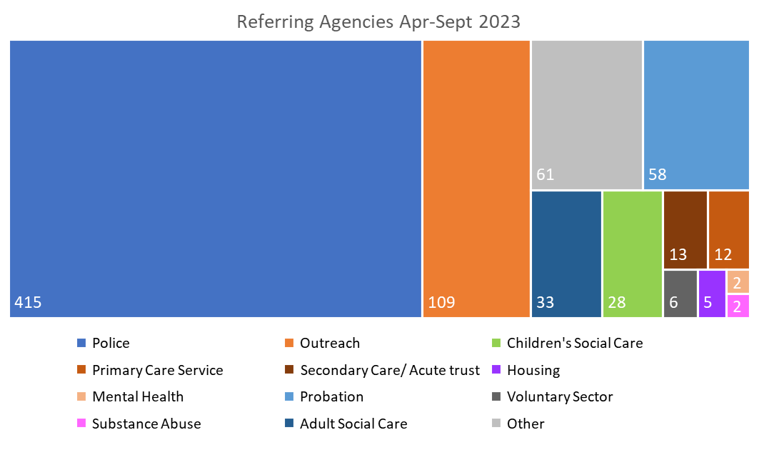
Where do referrals come from?

Slide 10
Agency Attendance (April 23 – September 23)

Slide 11
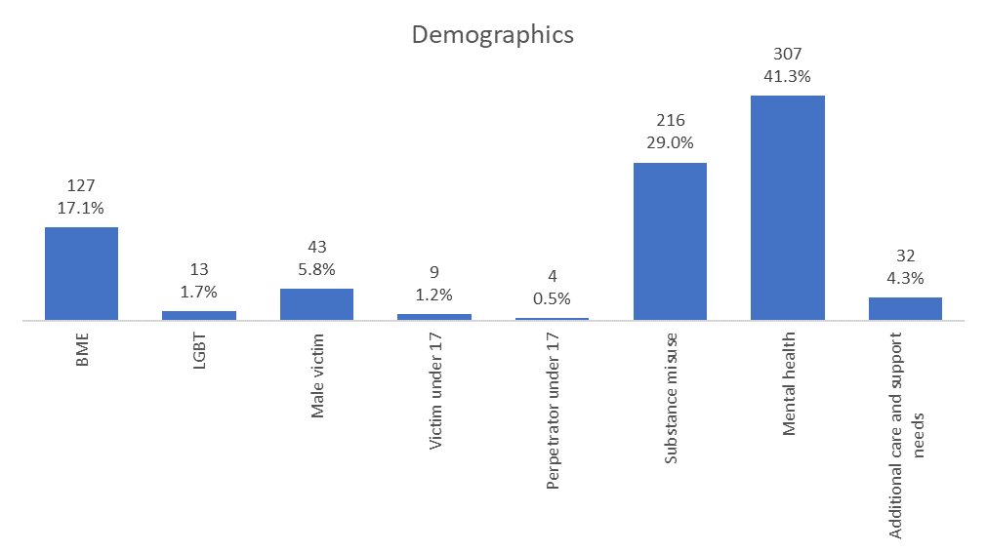
Demographics & Characteristics
The most common features of MARAC cases continue to be mental health concerns and substance misuse.
The percentage of LBGT cases has risen slightly to 1.7% from 1.1% in the previous 6 months, while the proportion of male victims has fallen from 9% to 5.8%. (Spelthorne had no LGBT or male victims.)
Cases where the individual has additional care and support needs have fallen to 4.3% from 5.3% in the previous 6 months.

Slide 12
Frequently Asked Questions
CONSENT – always advisable to gain consent from the survivor as safety planning is almost always more effective if the victim is happy to engage with support services but when considering the safety of people who are at high risk of harm, consent is not always necessary. If you are referring to MARAC then refer to Outreach too.
REFERRAL QUALITY – Explain why the referral is being made, why is it high risk and what support is required.
OFFENCES – Report via 101 / 999
POST-MARAC – The IDVA or equivalent lead professional will let the survivor know about the meeting, the safety plan and the support available. Actions will be progressed by relevant agencies to further the safety plan. Minutes will be uploaded onto MODUS together with action progress.

Slide 13
Outreach Support
Your Sanctuary

Slide 14
Outreach Support
Emotional & Practical Support
Signposting
Safety Planning
Advocacy - including support at court and attending social care meetings
Survivor’s voice at MARAC
Updating on actions & outcomes of MARAC

Slide 15
Identifying Abuse
Professional curiosity and assertiveness
Speak to service user away from family members or partner (domestic abuse is not limited to intimate partner)
Patterns of behaviour
Risk Assessment
A DASH Risk Assessment does not have to be completed by a DA specialist, and a referral to MARAC can be made on professional judgement.
Helpline for Advice – 01483 776822
Anti Victim Blaming Guidance
https://www.healthysurrey.org.uk/domestic-abuse/professionals/anti-victim-blaming-guidance
Surrey Gold Standard Coercive and Controlling Behaviour Framework
https://www.healthysurrey.org.uk/domestic-abuse/professionals/surrey-gold-standard-coercive-and-controlling-behaviour-framework

Slide 16
High Risk Indicators
Survivor fear
AP & Survivor mental health
Separation
Stalking
Pregnancy
Weapons
Threats To Kill
Non-Fatal Strangulation
Sexual abuse
Previous criminal history including violence
Mistreating an animal
Substance misuse
Threats of suicide by the perpetrator
Survivor mental health
If high risk abuse is identified, clients should be referred to both Outreach and MARAC

Slide 17
Why is multi-agency working between ASC, Outreach and MARAC so important?
Abuse may have been disclosed to only one service
Lesser-known indicators of abuse may be missed
Identifying perpetrator behaviours
Opportunities to raise safeguarding concerns missed
Appropriate level of support or intervention – especially mental health support
Informed decision-making
Supporting survivors who are neurodiverse

Slide 18
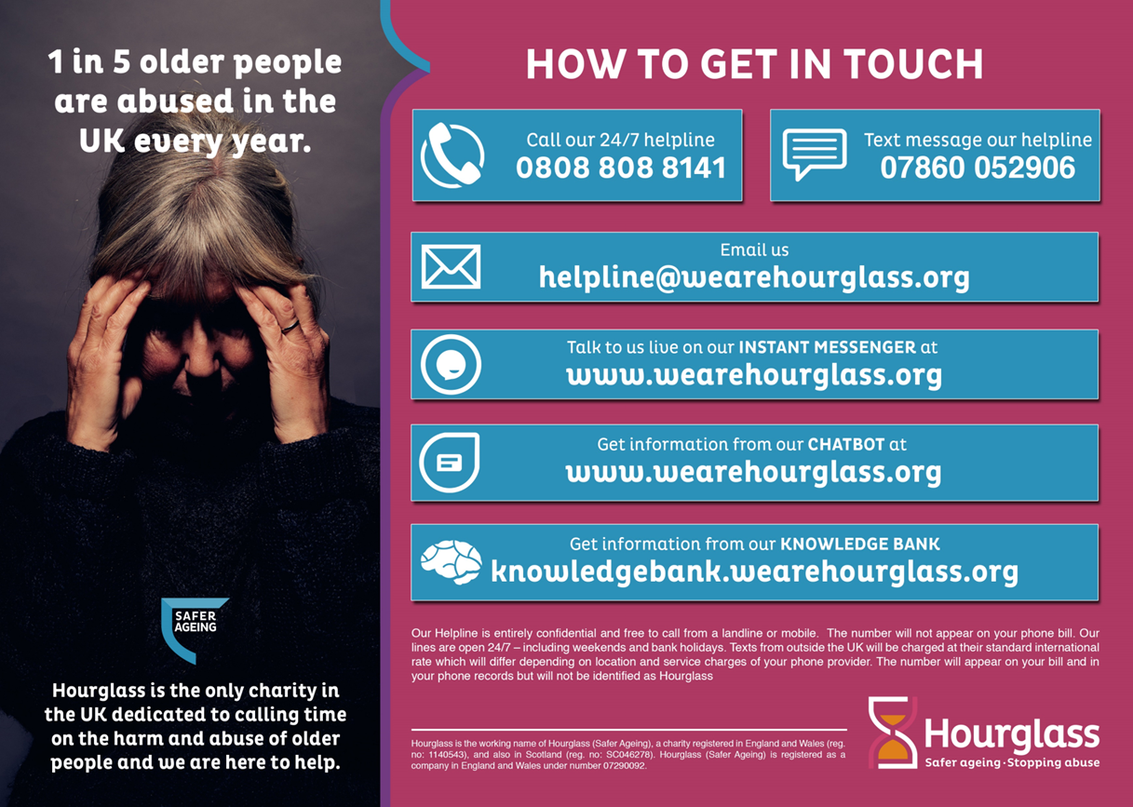
Hourglass

Slide 19
Case Studies – Adult Social Care
Positive Case Example 1
Libby (name changed), 56 years, lives a PA Housing owned property.
Libby has a diagnosis of EUPD and hip joint issues.
Libby called the police due to an assault from her partner Joe (name changed).
Libby was not supporting a police investigation, so case was filed.
The ASC team opened a Care Act Section 42 safeguarding enquiry due to concerns about domestic abuse.
Her case was discussed at the MARAC. An agreed action was for a joint visit with ASC and PA Housing.
Libby was connected with professionals and agencies she had been avoiding and this was a positive outcome.

Slide 20
Case Studies – Adult Social Care
Positive Case Example 2
In a case of DA when someone was ready to flee it was great to get the coordination from SW domestic outreach and Waverley housing.
The police were also able to put a marker on the property and advise everyone why they were not going to take action in relation to the stalking element of the DA at this critical point.
This was a great example of a team of multi agency /professionals working together to share information and advice to reduce the risk of harm coming to this individual.
The success in this case was that this person did flee, did so safely and had a new home to go to that could accommodate her disabilities.

Slide 21
Case Studies – Adult Social Care
Mr and Mrs Smith were known to MARAC as a high risk repeat DA case. They were both late 60’s/early 70’s.
Mrs Smith was terrified of her husband and spent the large part of their marriage placating him and being careful not to upset him. The control and DA incidents had increased since he retired.
He monitored everything she did and asked questions about why she was late, there was a real degree of coercive control which had increased. It was manageable while he was working.
Agencies were concerned about the risk of a domestic homicide due to his anger and physical abuse, her age and general health.
Police were called to the property, where he was arrested several times although always went home afterwards, despite police bail conditions in place which he constantly breached and Mrs Smith had always allowed him home afterwards, against agencies advice. In the hope that he would change his behaviour, although this never happened.
She would not consider leaving him, despite the efforts from ASC and ESDAS (DA outreach services).
She was a carer under the care act definition. Mrs Smith had some depression and anxiety due to the DA and this was being managed by her GP.
Risk assessments were conducted in the S42 enquiry, and a DASH risk assessment completed by ESDAS.
Then Mr Smith was admitted to hospital. This was our window of opportunity to speak to her, without him being there, and support her, on this occasion she agreed not to have him back to their home and he was placed by ASC in a respite bed funded by SCC from hospital.
Once Mrs Smith had realised the degree of distress and anxiety that Mr Smith had caused her, she worked with ESDAS and ASC and the locks were changed and door bolts and other safety equipment such as DA kits were put in place. As agencies were concerned that he might leave the care home and make his way back home.
However, his health deteriorated, and home was no longer an option.
So, all in all this took many attempts to engage her and offer her support from ESDAS and ASC and all agencies were relieved that she could live out the rest of her life in safety.

Slide 22
Questions?

Slide 23
Emergency Contacts
Surrey Helpline for Advice – 01483 776822
In an emergency dial 999
24-hour National Domestic Abuse Helplice – 0808 2000 247
Speak to someone trained to provide you with emotional and practical support:
If you need to talk to someone Monday to Friday 9.00am to 4.00pm you can call your local support service direct using the numbers below, or you can call the Surrey Domestic Abuse Helpline provided by Your Sanctuary, currently available 9am to 2pm and 5pm to 9pm Monday to Friday.
East Surrey Domestic Abuse Services covers Mole Valley, Reigate & Banstead & Tandridge Tel: 01737 771350
Your Sanctuary covers Woking, Runnymede and Surrey Heath Tel: 01483 776822
North Surrey Domestic Abuse Services covers Epsom and Ewell, Elmbridge and Spelthorne Tel: 01932 260690
South West Surrey Domestic Abuse Services covers Guildford and Waverley Tel: 01483 898884

